Slide 1
Hnefatafl
CS414 Object-Oriented Design
--Party A

Slide 2
CONTENTS
Hnefatafl
User Stories
CRC Card & Diagram
Development Manual
Sprint Review and Retrospective

Slide 3
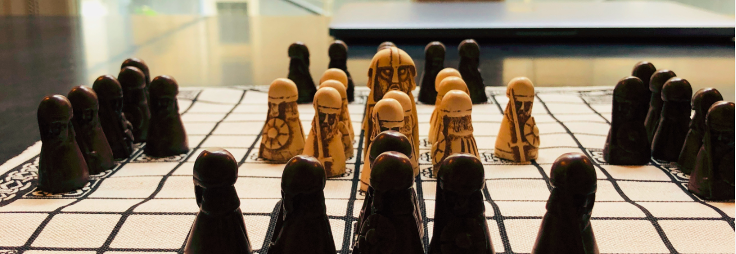
Hnefatafl
Checkered Gameboard
Protect the king
Catch the king
a checkered gameboard with two armies of
uneven numbers
12 pawns and a king
24 pawns
Picture Source: the picture from the network. https://zhuanlan.zhihu.com/p/33300643

Slide 4
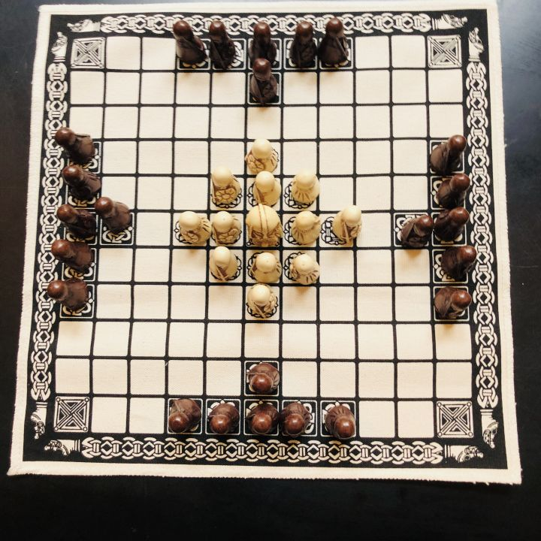
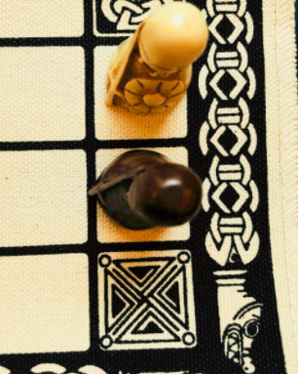
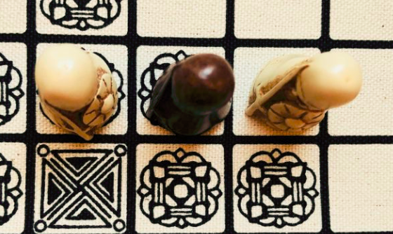
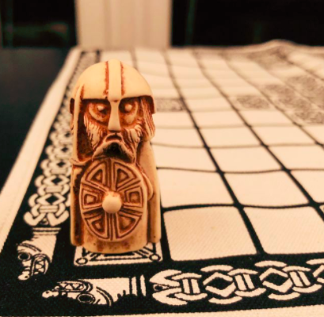
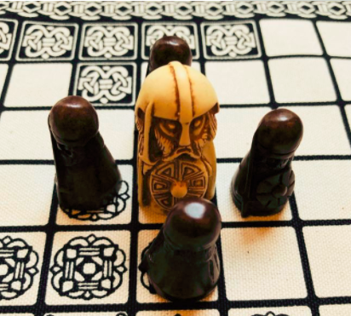
Hnefatafl
All pieces move like a Rook in chess.
Pieces are taken when an opponentʼs
piece is trapped between two of yours
The protector wins by moving the king
to one of the four corners of the
chessboard
The other side wins if they capture
the king
Picture Source:
the picture from the network.
https://zhuanlan.zhihu.com/p/33300643

Slide 5
User Stories

Slide 6

User Stories
1. As a user, I want to register to this platform by using an email, nickname and a password.
2. As a user, I want to login to this platform using the account I registered.
3. As a user, I want to be able to play Hnefatafl.
4. As a user, I want to invite another user who is online to start a game.
5. As a user, I want the user who is invited to a game to be able to either accept or ignore.
6. As a user, I want to receive a notification if the other user accepts or rejects my invitation.
7. As a user, I want to send more than one invitation.
8. As a user, I want to play multiple games at the same time.
9. As a user, I want to be able to view the history of previous games including the result of the game, the opponent, and the number of moves.
10. As a user, I want to know when it is my turn.
11. As a user, I want to have rules and tutorials before I start playing the game for the first time.
12. As a user, I want to be able to quit from any game of Hnefatafl at any time.
13. As a user, I want to be able to logout from my account when I do not want to play, and receive a prompt before it exits.
14. As a user, I want to be able to unregister my entire account from the platform.

Slide 7
Sprint 1 Focus
As a user, I want to register to this
platform by using an email, nickname,
and a password.
As a user, I want to login to this
platform using the account I registered

Slide 8
CRC Cards &
Class Diagram

Slide 9
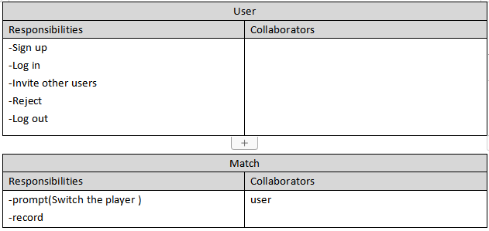
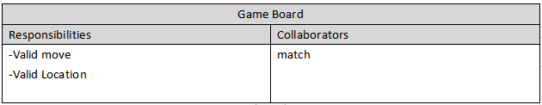
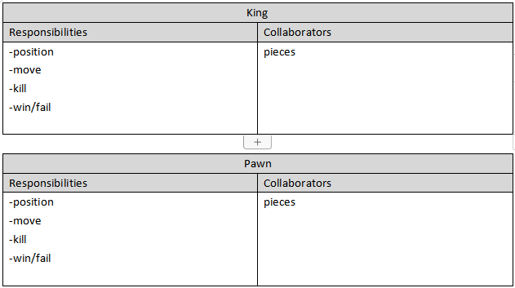
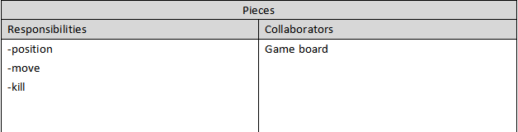
CRC Cards &Class Diagram

Slide 10
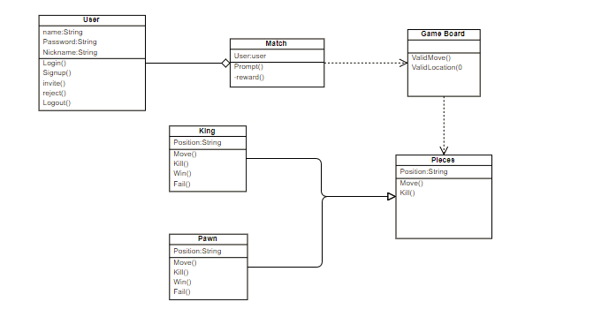
CRC Cards &Class Diagram

Slide 11
Development
Manual

Slide 12
Development Manual
The Development Manual is a comprehensive, composite artifact that gathers all information required to manage the project.
It is like a user guide, which is a short reference to some particular
aspects of a software project.
The Development Manual contains all essential information for the
user to make full use of the information system.
This manual includes a description of the system functions and
capabilities, contingencies and alternate modes of operation,
and step-by-step procedures for system access and use.

Slide 13
Development Manual
Hnefatafl is a family of 2-player Viking board games. Right now, we're implementing the
popular 11x11 variant. To develop this game, we need to follow the following steps:
STEP 1: Download the JDK
STEP 2: Set Up a Development Environment
STEP 3: Application
Testing Phase: 3 A's
1. Arrange: consists of a few lines of code that are used to declare and initialize the objects
2. Act: is usually a few lines of code where we perform the actions,
whether it is some calculation or modify the state of our objects.
3. Assert: usually consists of a single line of code where we verify that the outcome of
the Act part was made successfully. Testing improves the quality of the code and it makes
the development process more Agile.

Slide 14
Development Manual
To run the tests:
Eclipse provides a couple of ways to run individual test methods,
one from within the editor itself and another from the JUnit view.

Slide 15
Sprint Review
and Retrospective

Slide 16
Sprint Review and Retrospective
Review:
Went over results of sprint
Met with product owner
Made changes as needed
Retrospective:
Identified what could improve
Identified what went well

Slide 17
Reference
1.Sten Helmfrid(2005),Hnefatafl - the Strategic Board Game of the Vikings. http://hem.bredband.net/b512479/#Chap9
2.Dragonheel’s Lair ,Rules of the game Hnefatafl. http://www.dragonheelslair.com/en/ruleshnef.php

Slide 18
THANK YOU FOR WATCHING

